Slide 1
Numerical Analysis (5/7) Ordinary Differential equations
University of Luxembourg - 2024
Master in Mathematics
Hadrien Beriot, Philippe Marchner

Slide 2
Outline
1. Introduction
2. Euler Methods
3. One step methods
4. Multi-step methods
5. Summary

Slide 3

1. Introduction

Slide 4
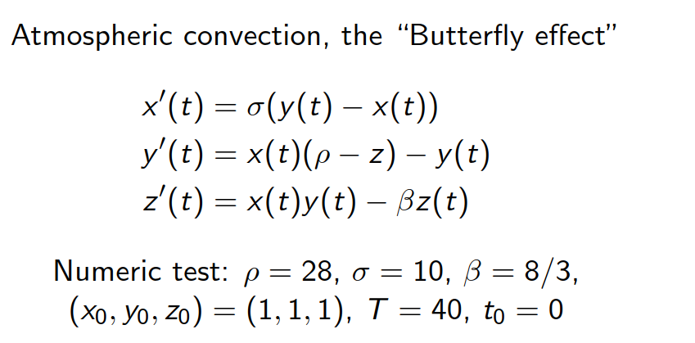
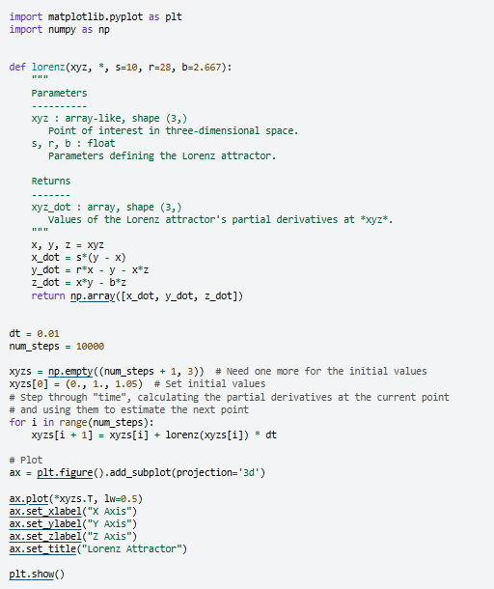
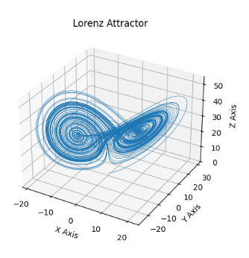
A famous example – The Lorenz system
https://matplotlib.org/stable/gallery/mplot3d/lorenz_attractor.html
Notes:
The image represents a Lorenz attractor, which is a three-dimensional chaotic attractor discovered by the mathematician Edward Lorenz.
The Lorenz attractor is a graphical representation of the solutions to a set of differential equations that describe a simplified model of atmospheric convection, known as the "Butterfly effect".
The image shows the characteristic butterfly-like shape of the Lorenz attractor, which demonstrates the sensitive dependence on initial conditions that is a hallmark of chaotic systems.

Slide 5
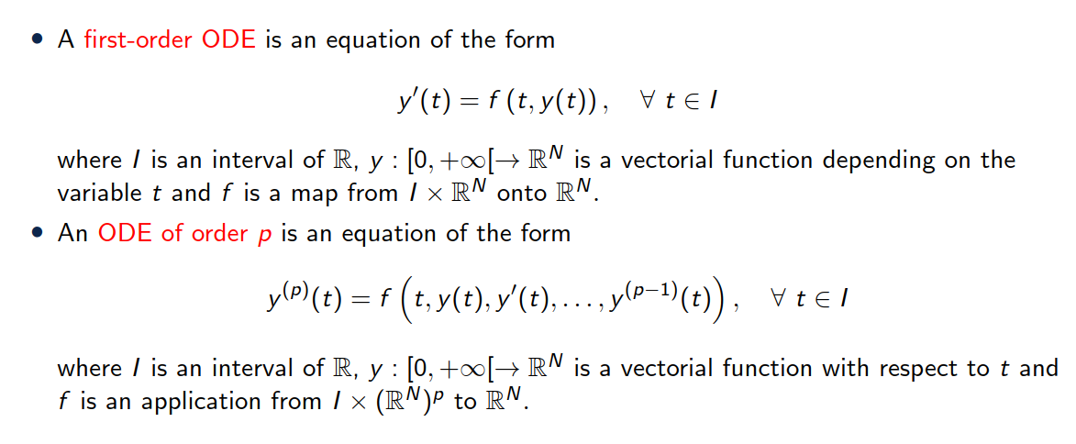
Definition

Slide 6
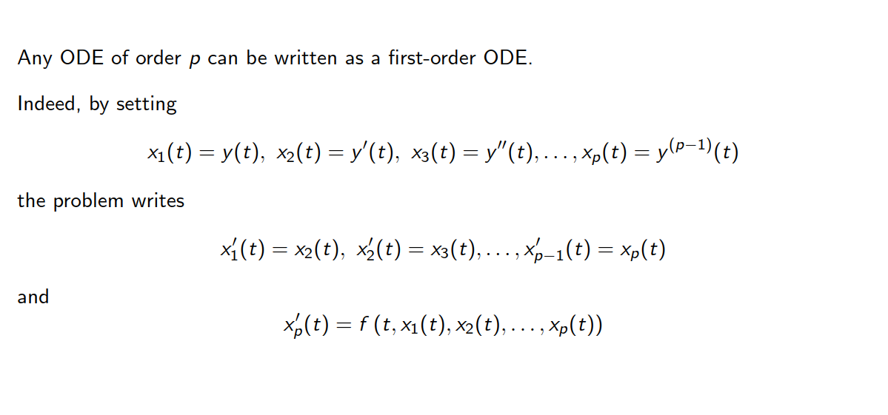
Remark

Slide 7
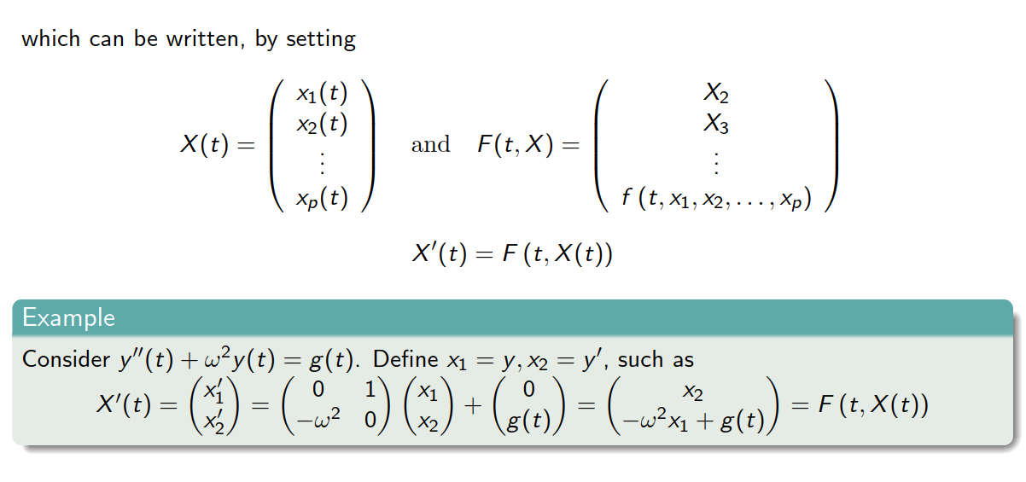
Remark

Slide 8
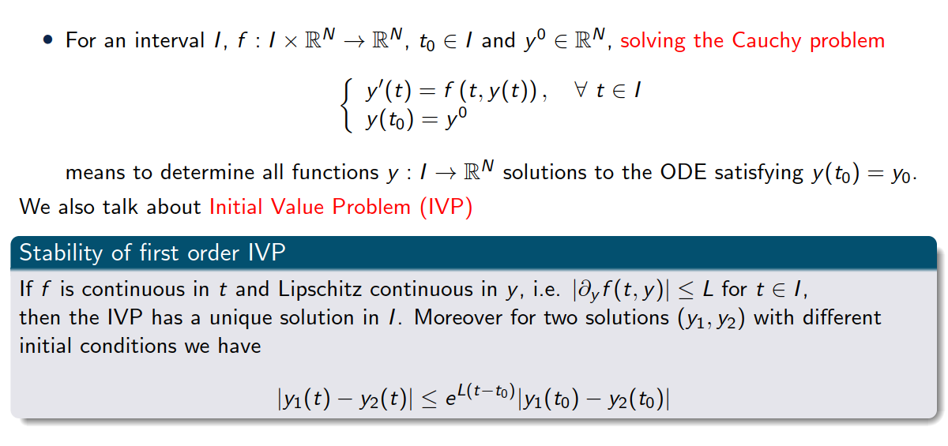
Definition – Initial Value Problem

Slide 9
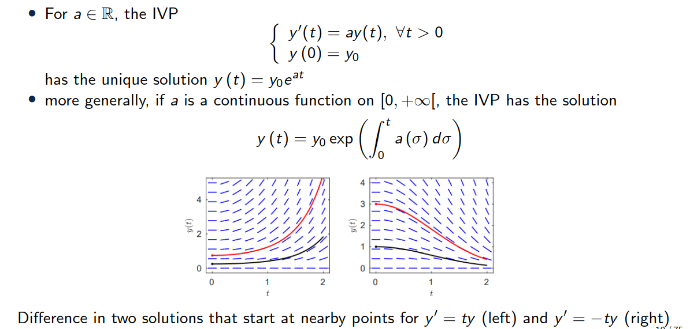
A simple example

Slide 10
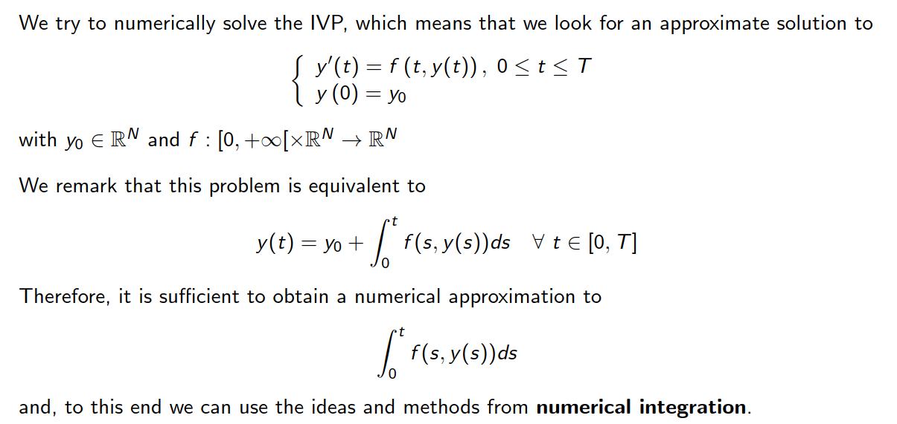
Numerical approximation

Slide 11
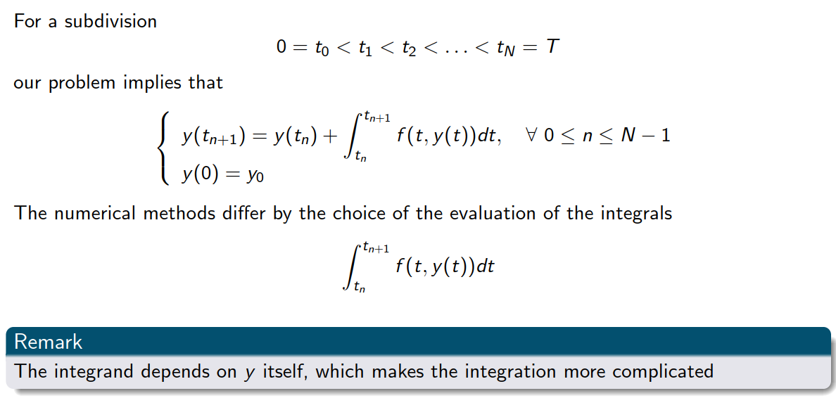
Numerical approximation

Slide 12
2. Euler Methods

Slide 13
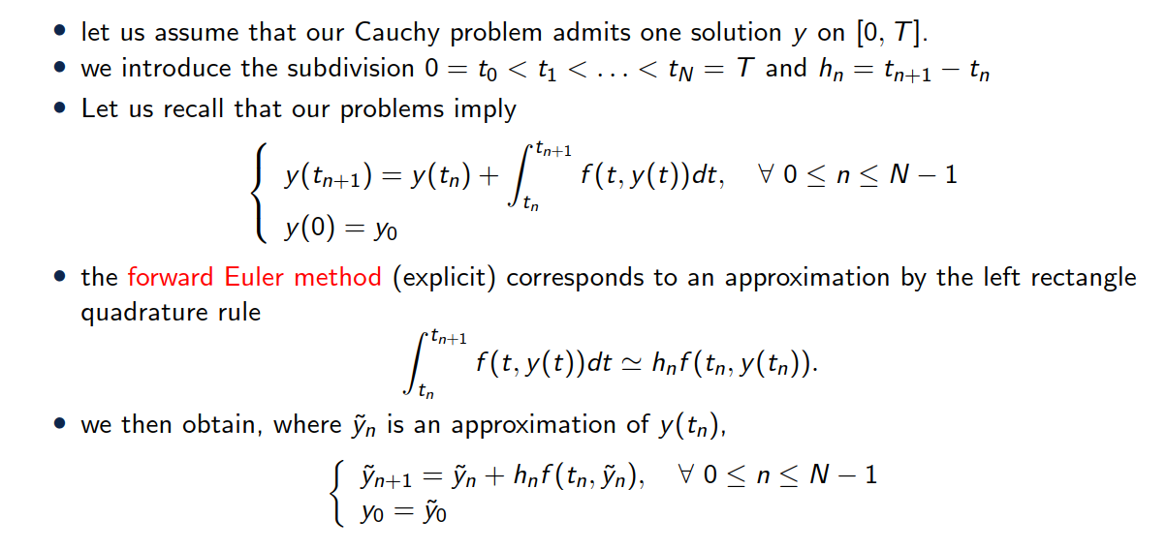
The forward Euler problem

Slide 14
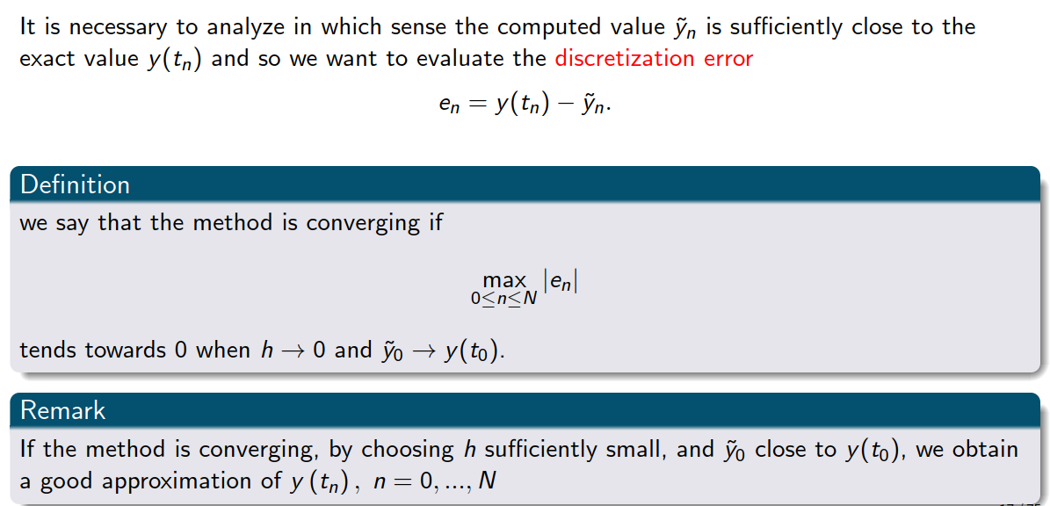
Convergence

Slide 15
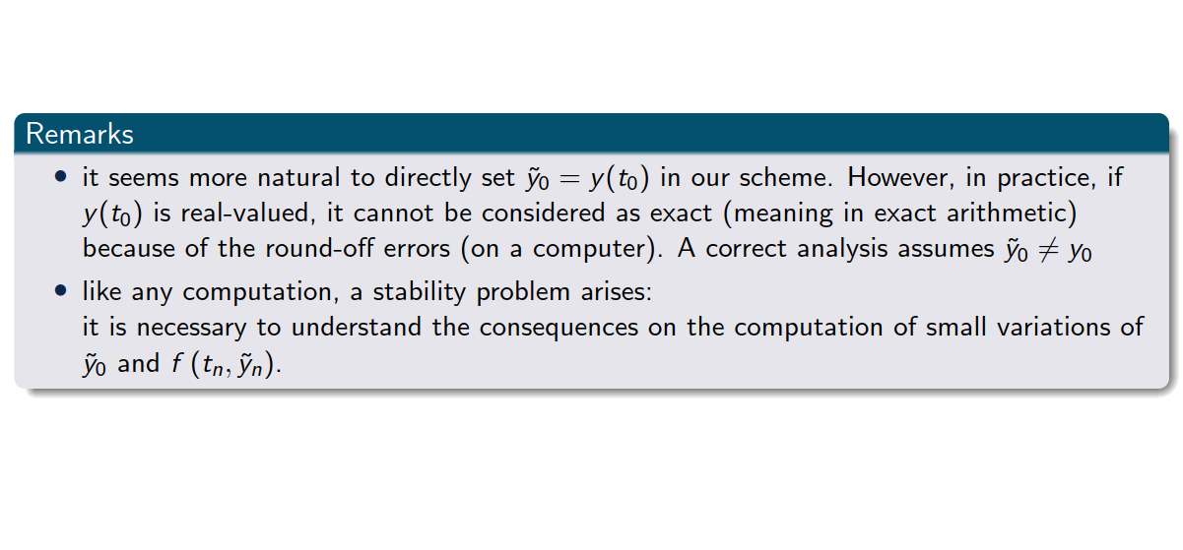
Convergence

Slide 16
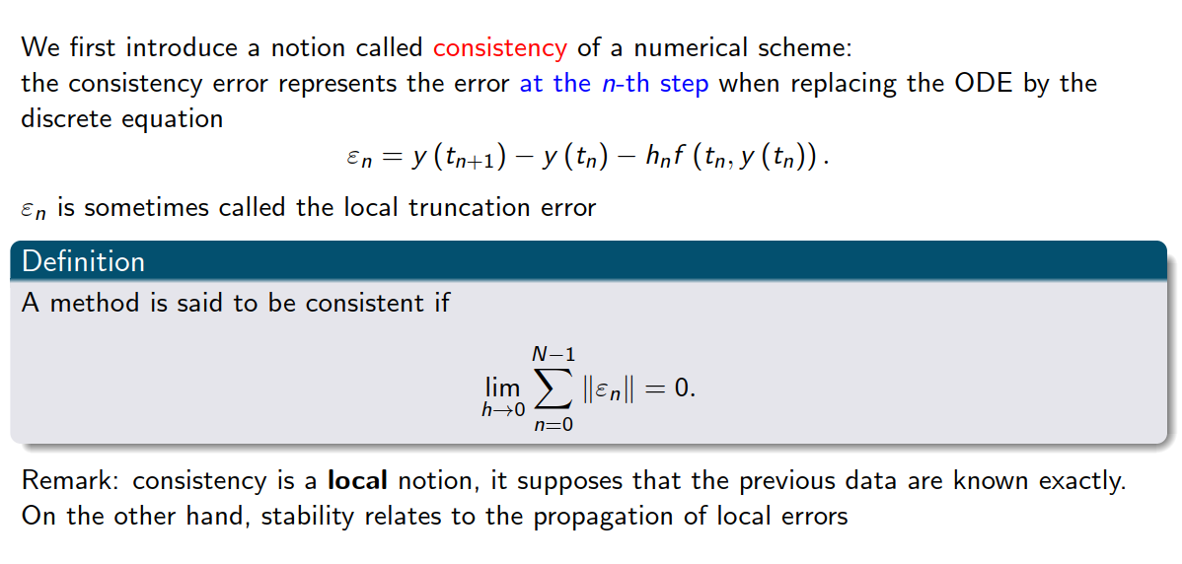
Consistency

Slide 17
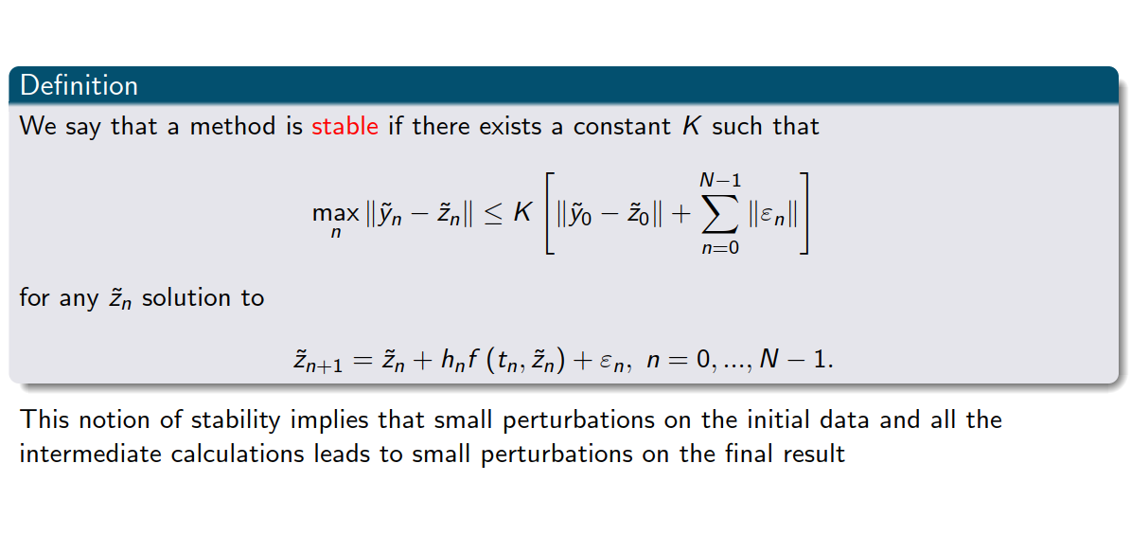
Stability

Slide 18
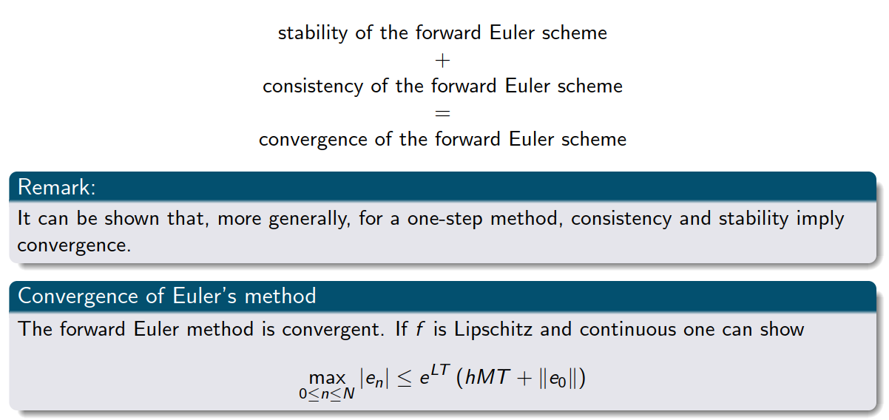
Back to convergence

Slide 19
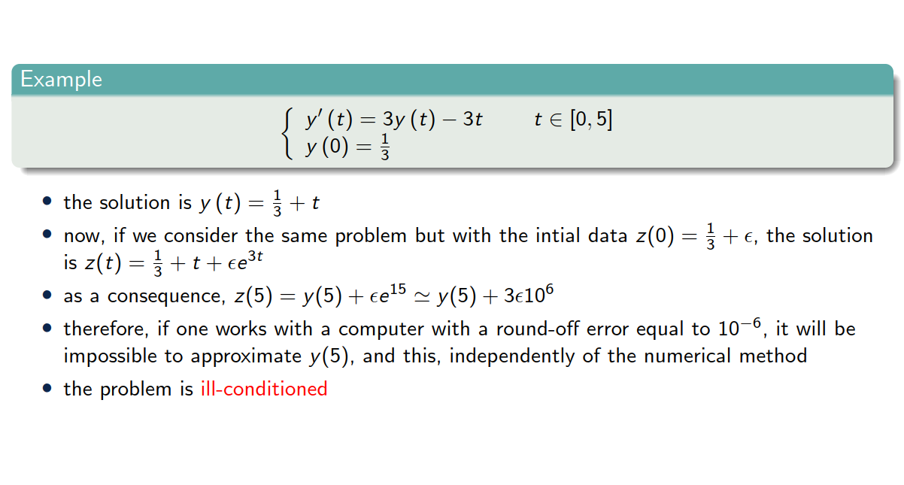
Example 1

Slide 20
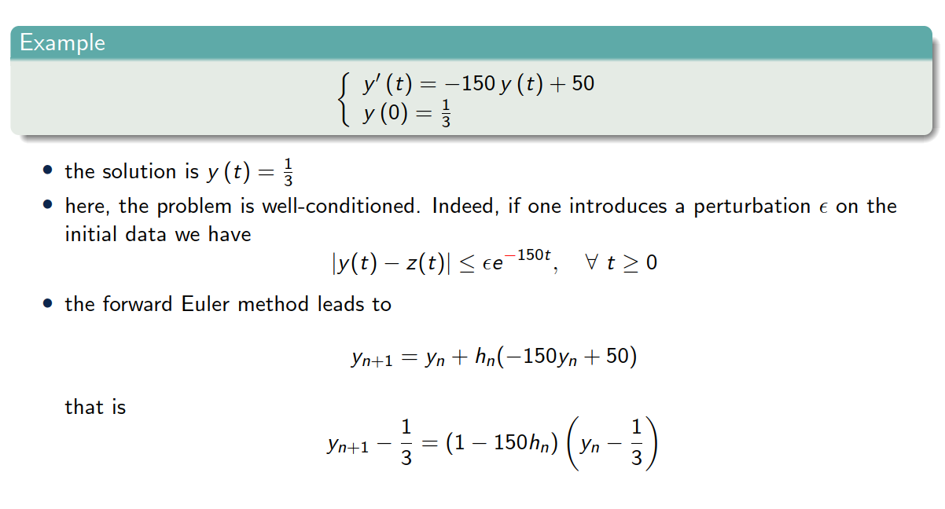
Example 2

Slide 21
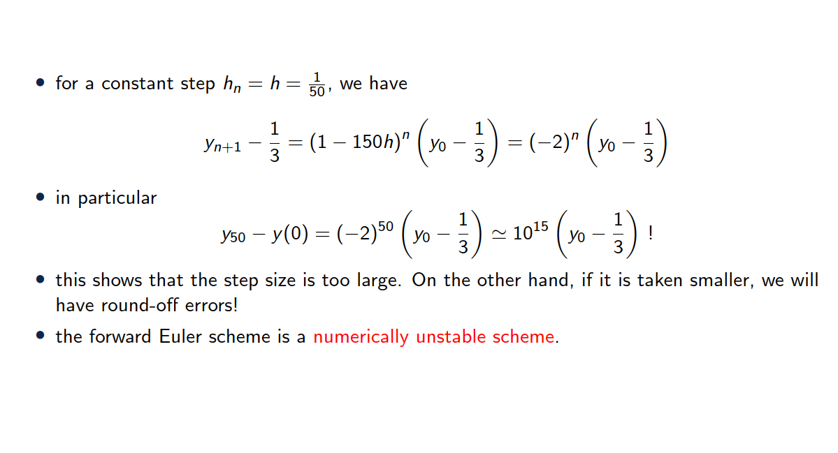
Example 2

Slide 22
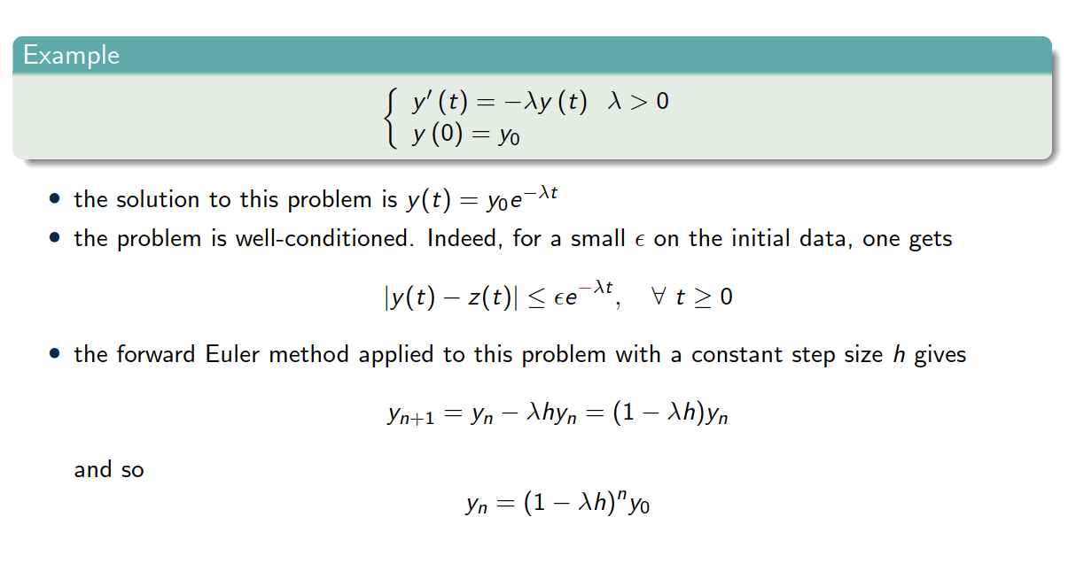
Example 3

Slide 23
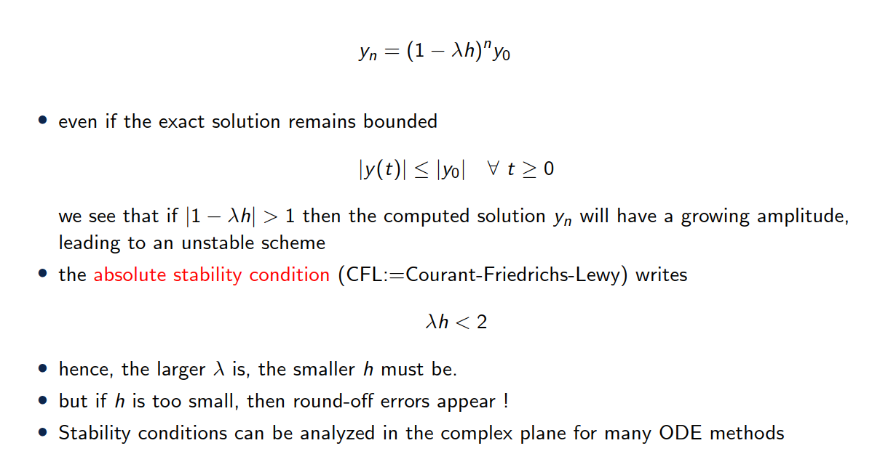
Example 3

Slide 24
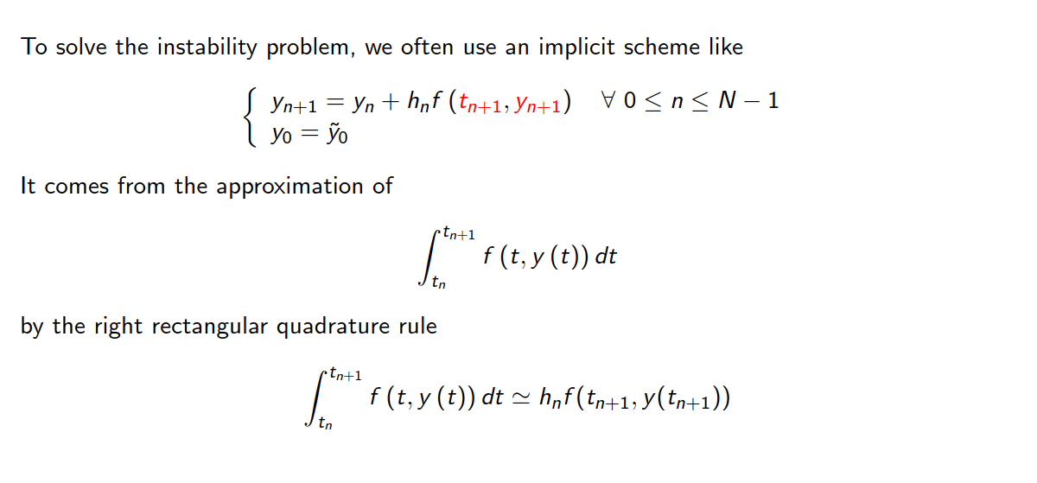
Backward Euler (implicit)

Slide 25
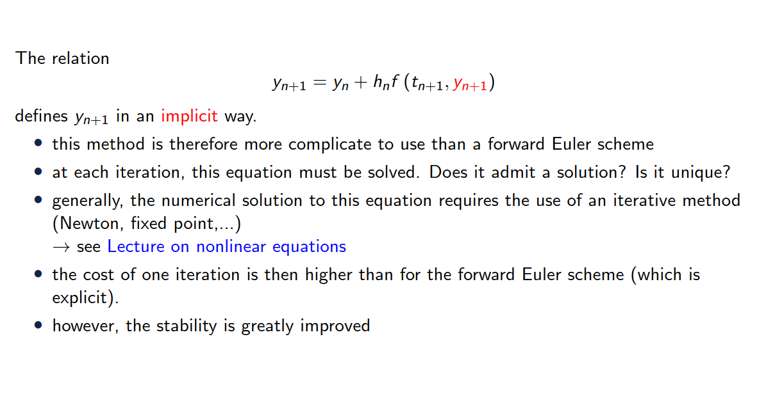
Backward Euler (implicit)

Slide 26
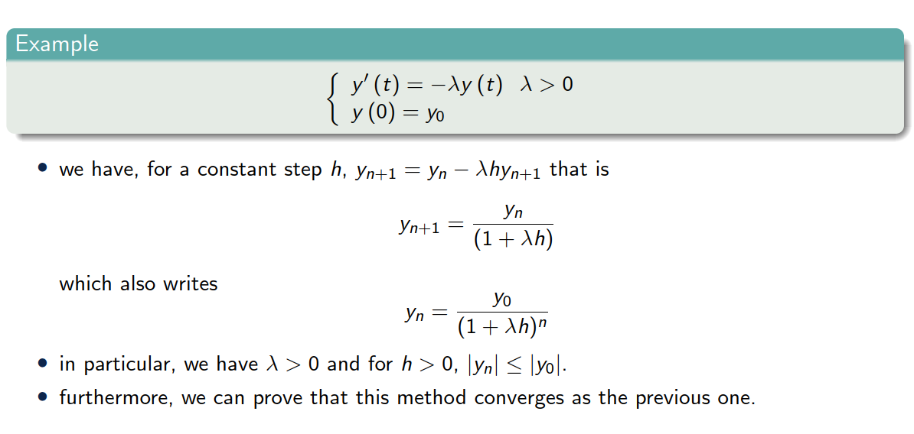
Back to example 3

Slide 27
3. One step methods

Slide 28
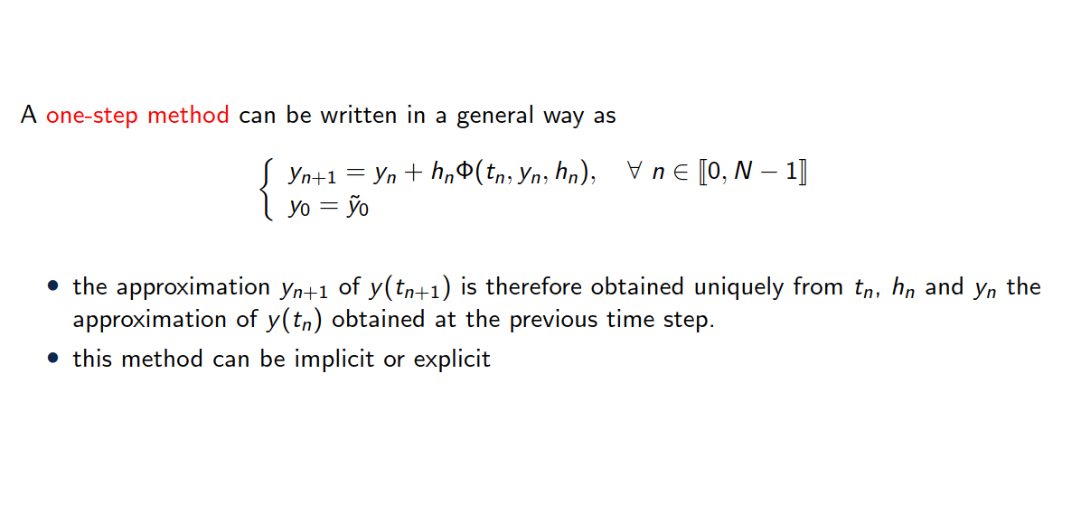
General study of one-step methods

Slide 29
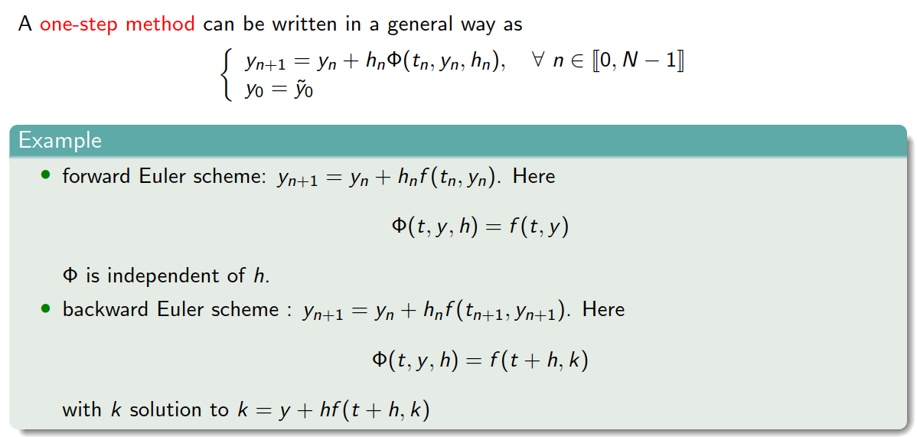
General study of one-step methods

Slide 30
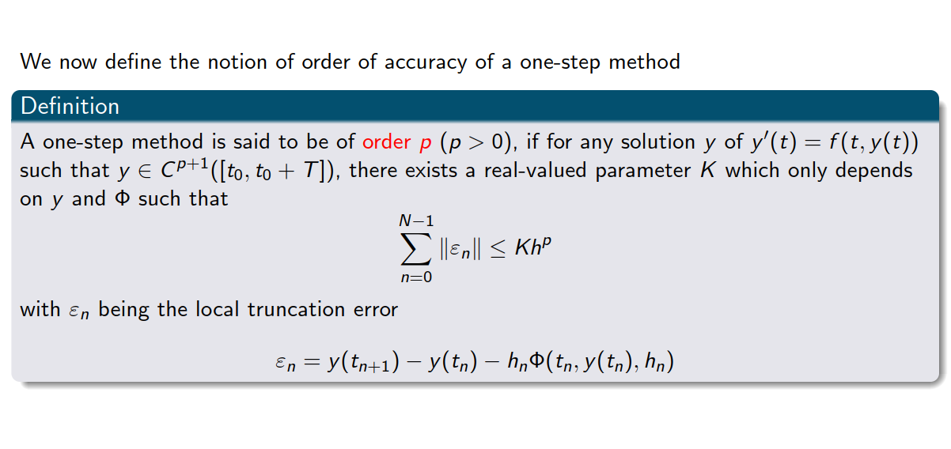

Slide 31
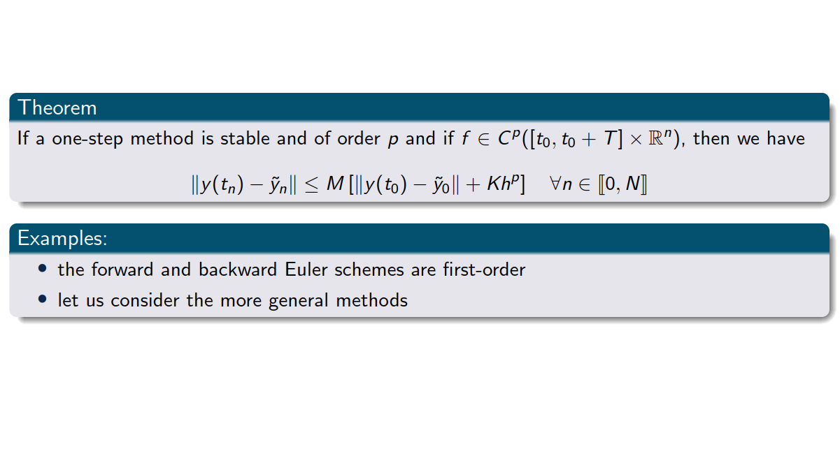
Order of accuracy

Slide 32
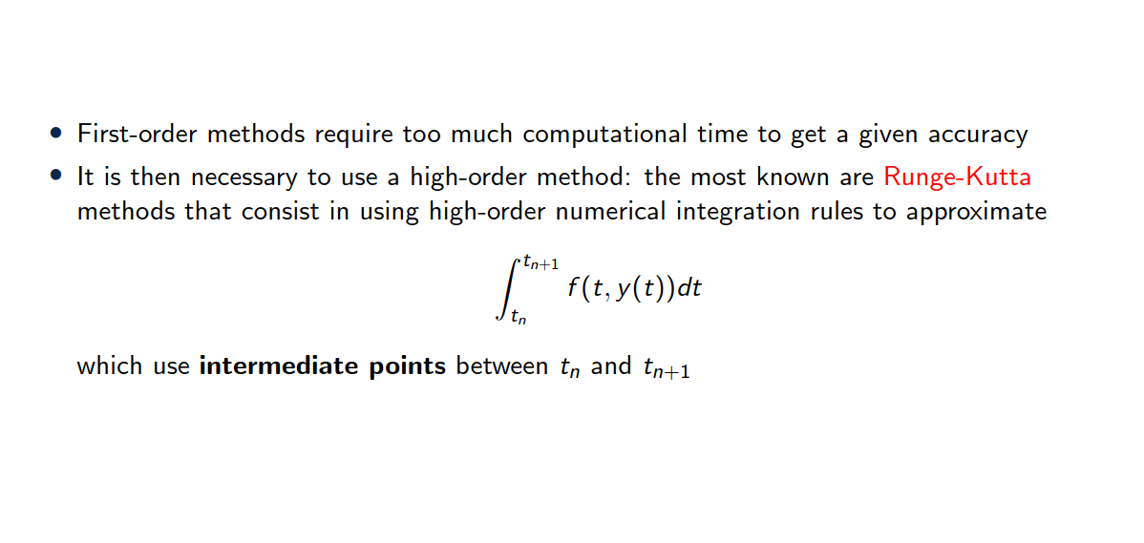
Runge-Kutta methods

Slide 33
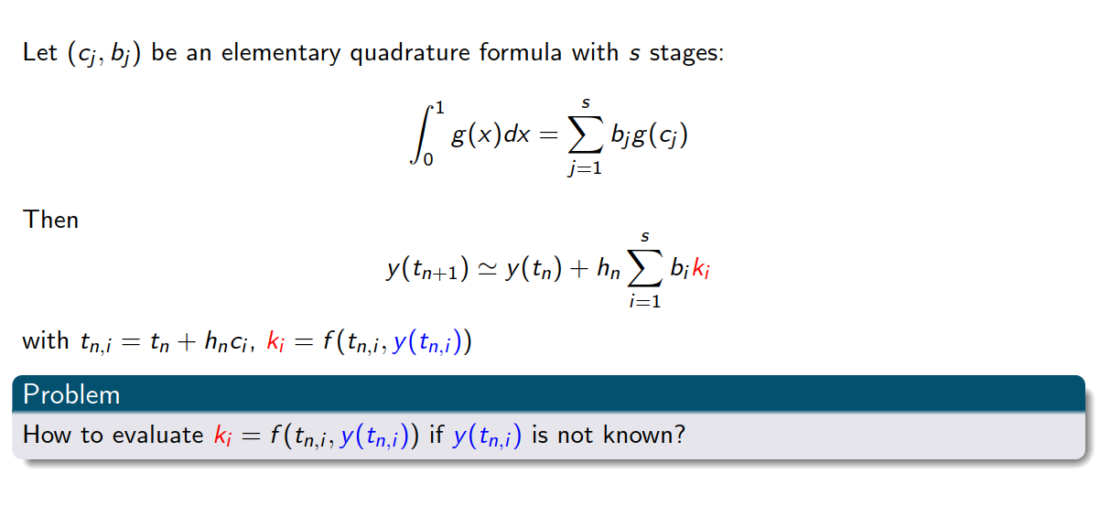
Runge-Kutta methods

Slide 34
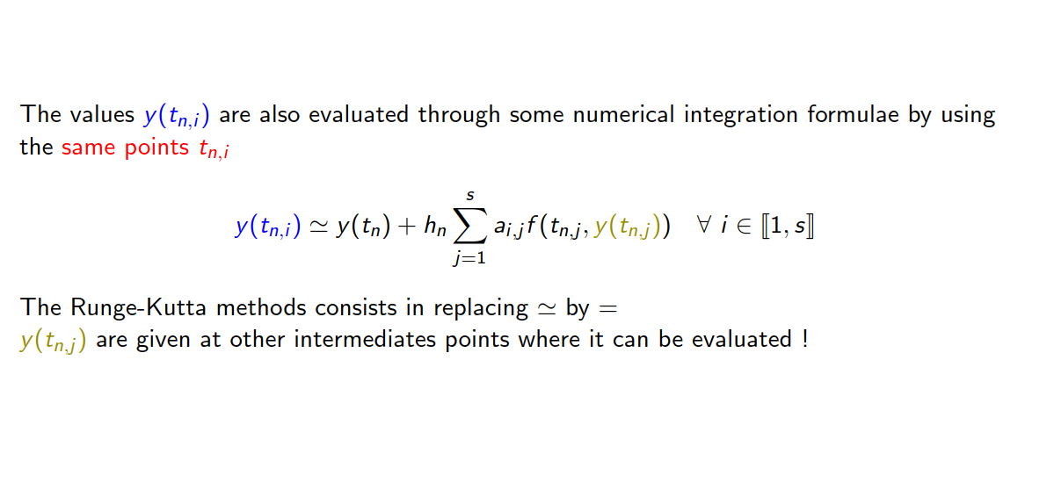
Runge-Kutta methods

Slide 35
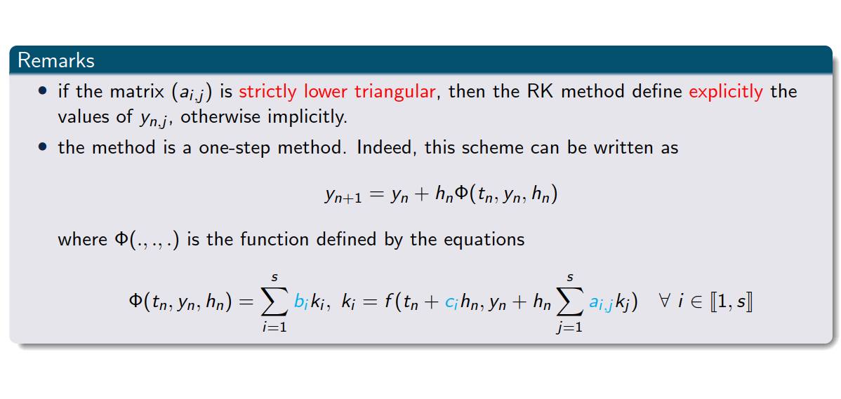
Runge-Kutta methods

Slide 36
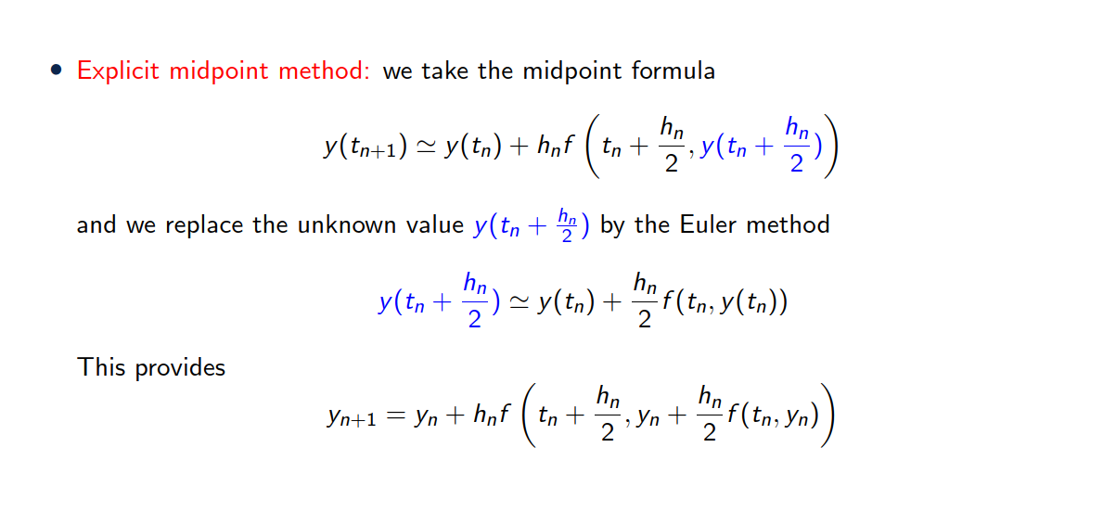
Examples of Runge Kutta method

Slide 37
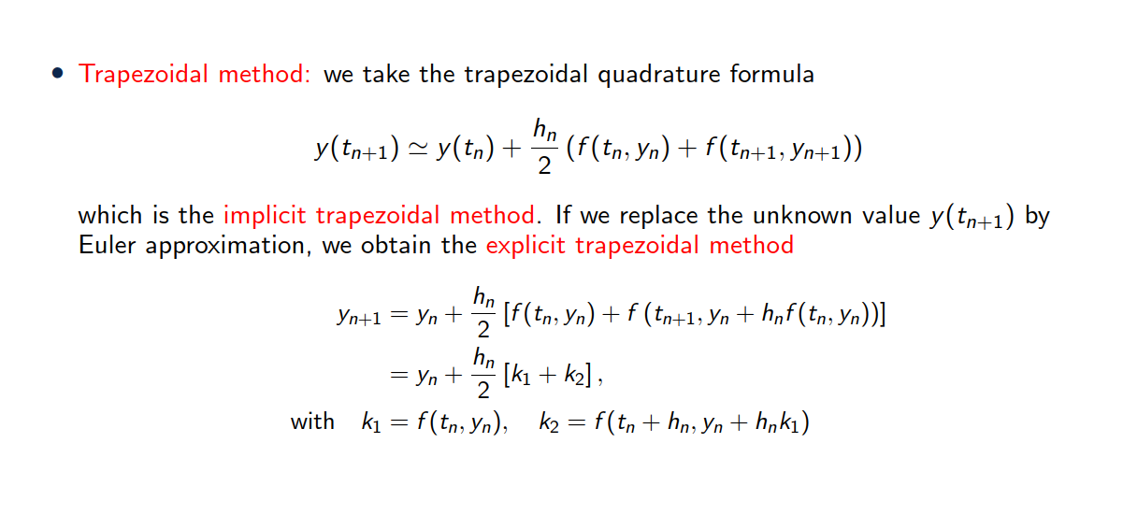
Examples of Runge Kutta method

Slide 38
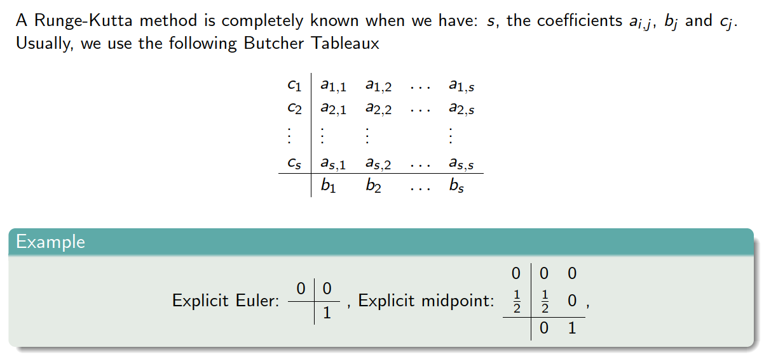
Butcher’s Tableaux

Slide 39
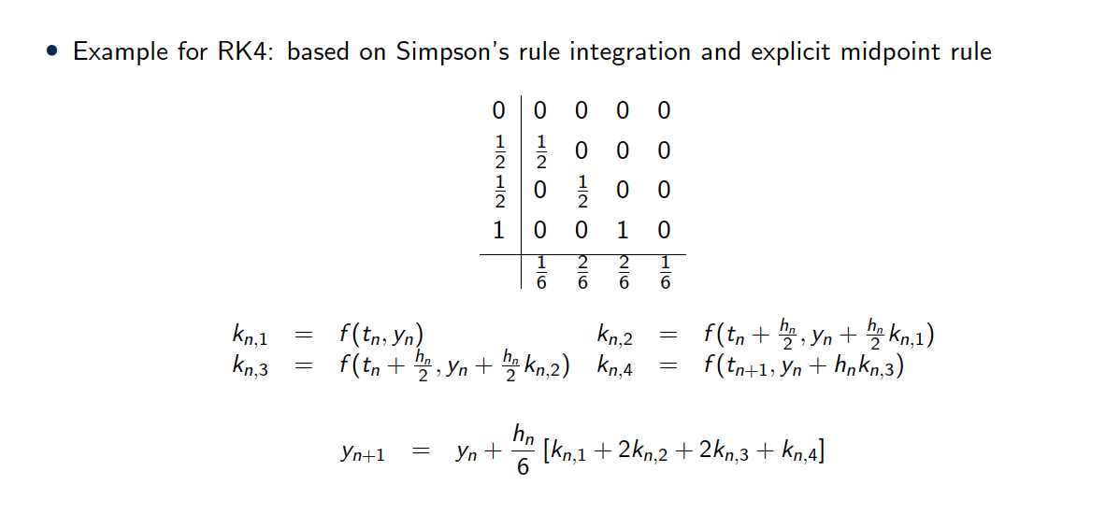
Runge Kutta 4 (RK4)

Slide 40
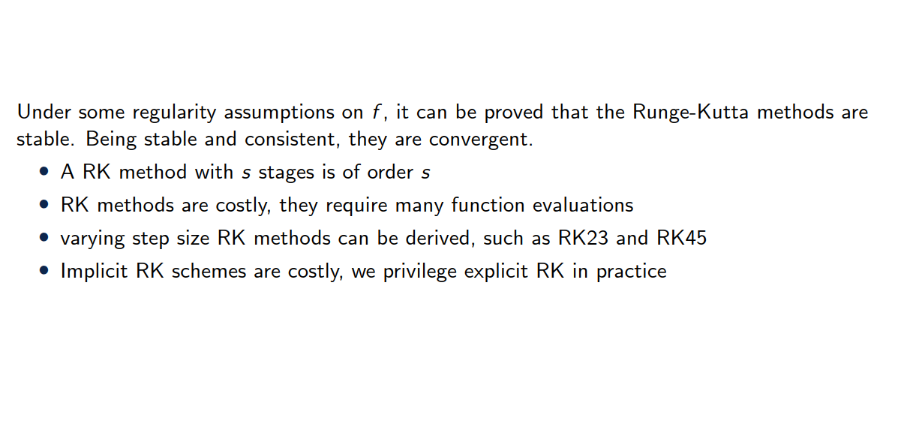
Remarks on Runge Kutta

Slide 41
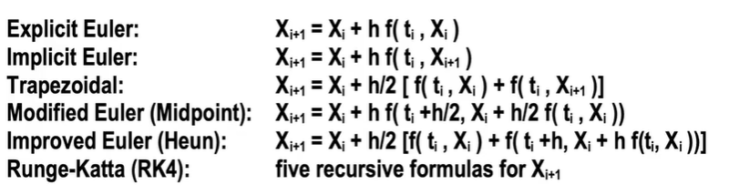
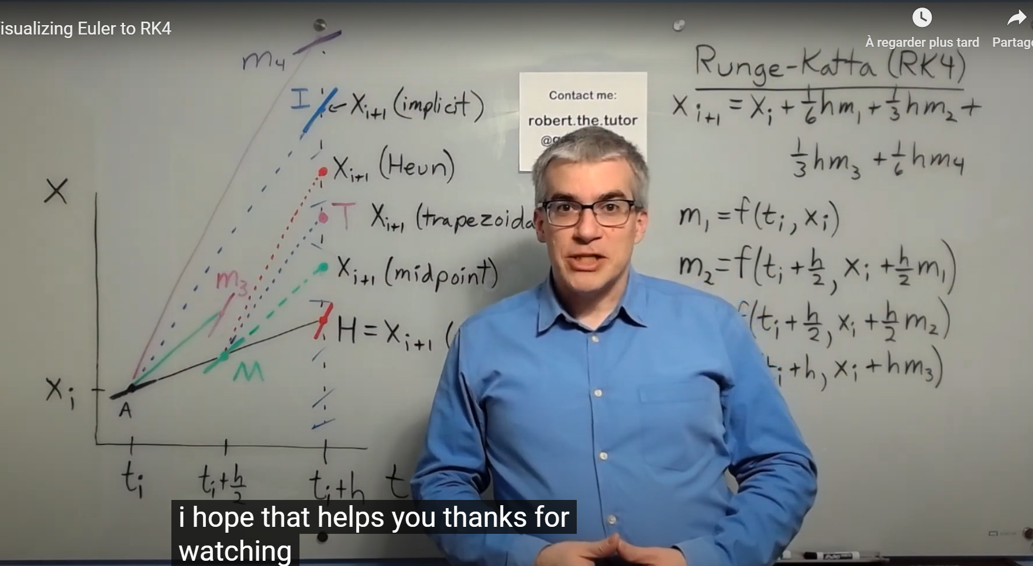
https://www.youtube.com/watch?v=cb5KnYj3fNY&t=189s
https://www.youtube.com/watch?v=dShtlMl69kY

Slide 42
5. Summary

Slide 43
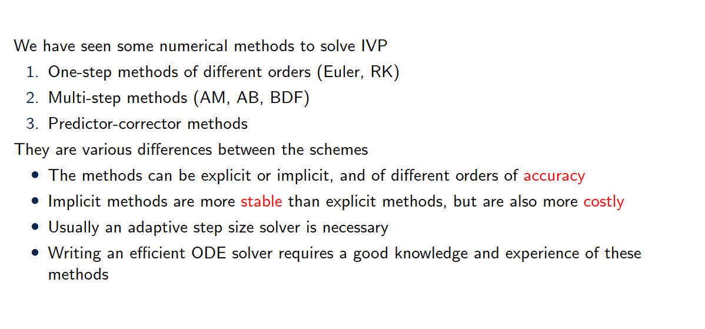
Summary

